Slide 1
PROJECT : 1
HIGHLY AVAILABLE STATIC WEBSITE
Launch EC2 in one availability zone
Configure security groups for HTTP and SSH
Attach EBS volume and host a static website
Store backups in S3
Create EBS snapshot and AMI
Launch EC2 in another AZ using AMI

Slide 2
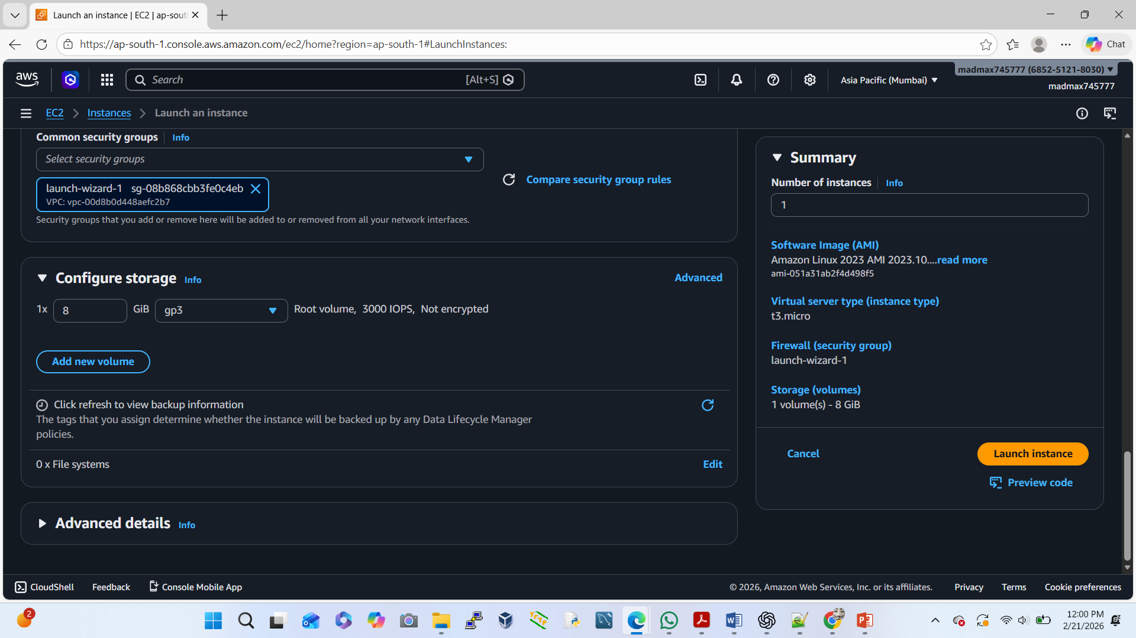
Launch EC2 in one availability zone

Slide 3
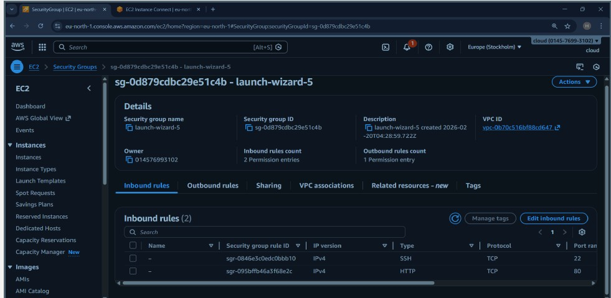
Create new security group configure security groups (HTTP and SSH)

Slide 4
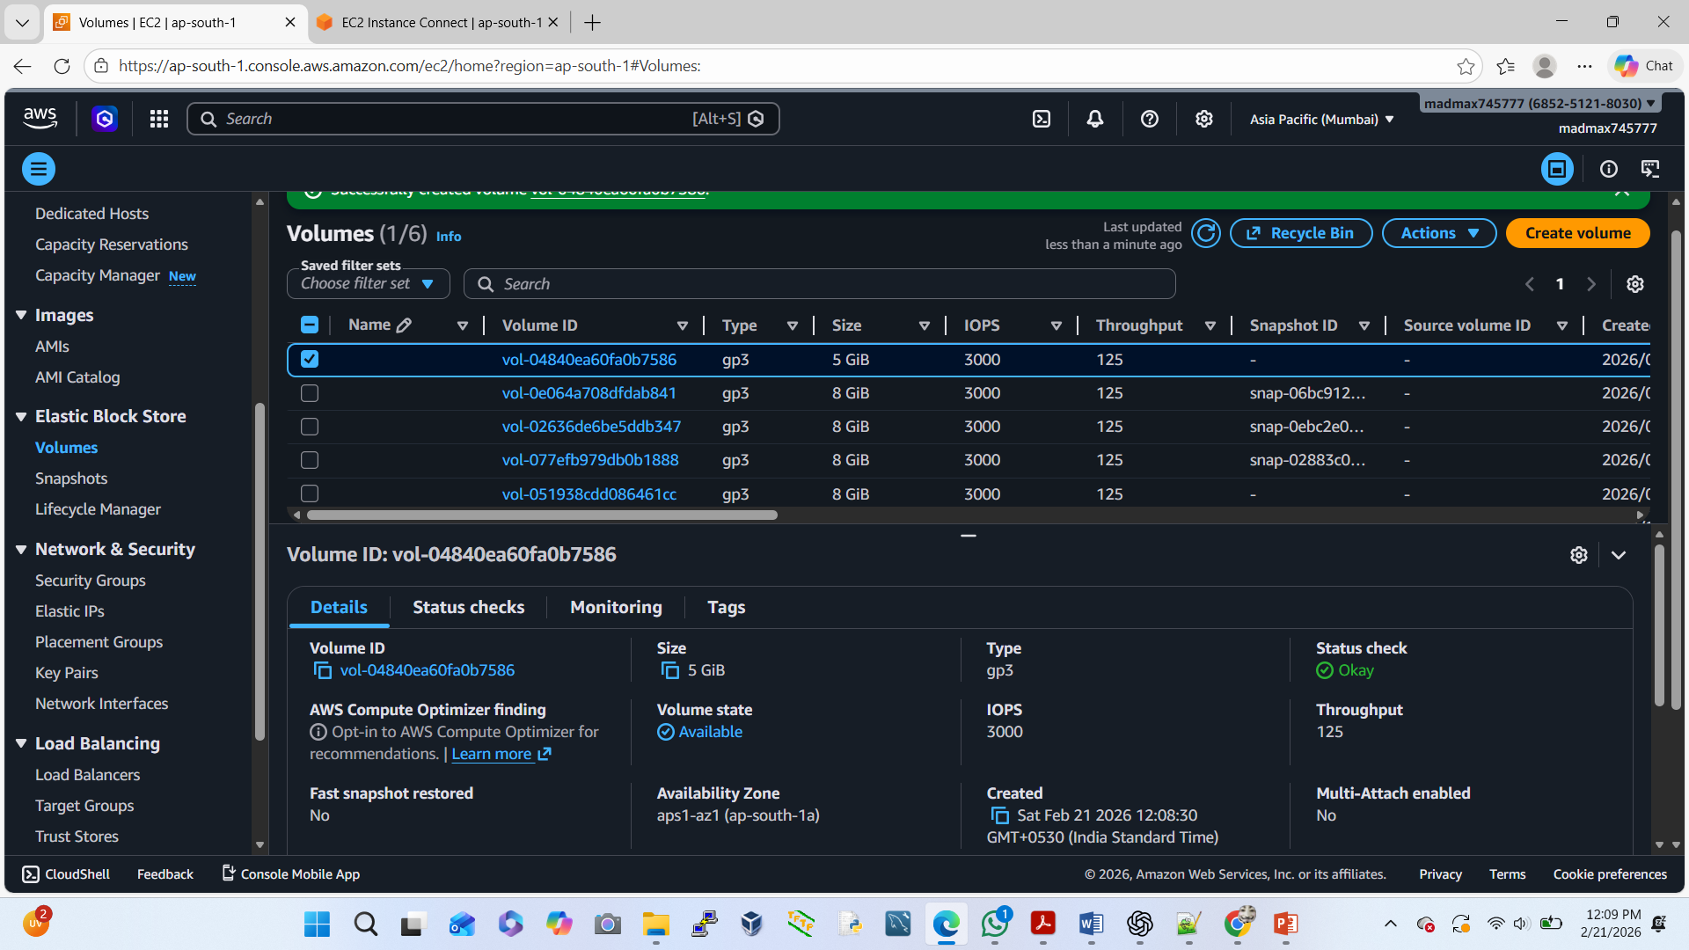
Attach EBS volume and host static website create and attach volume to instance

Slide 5
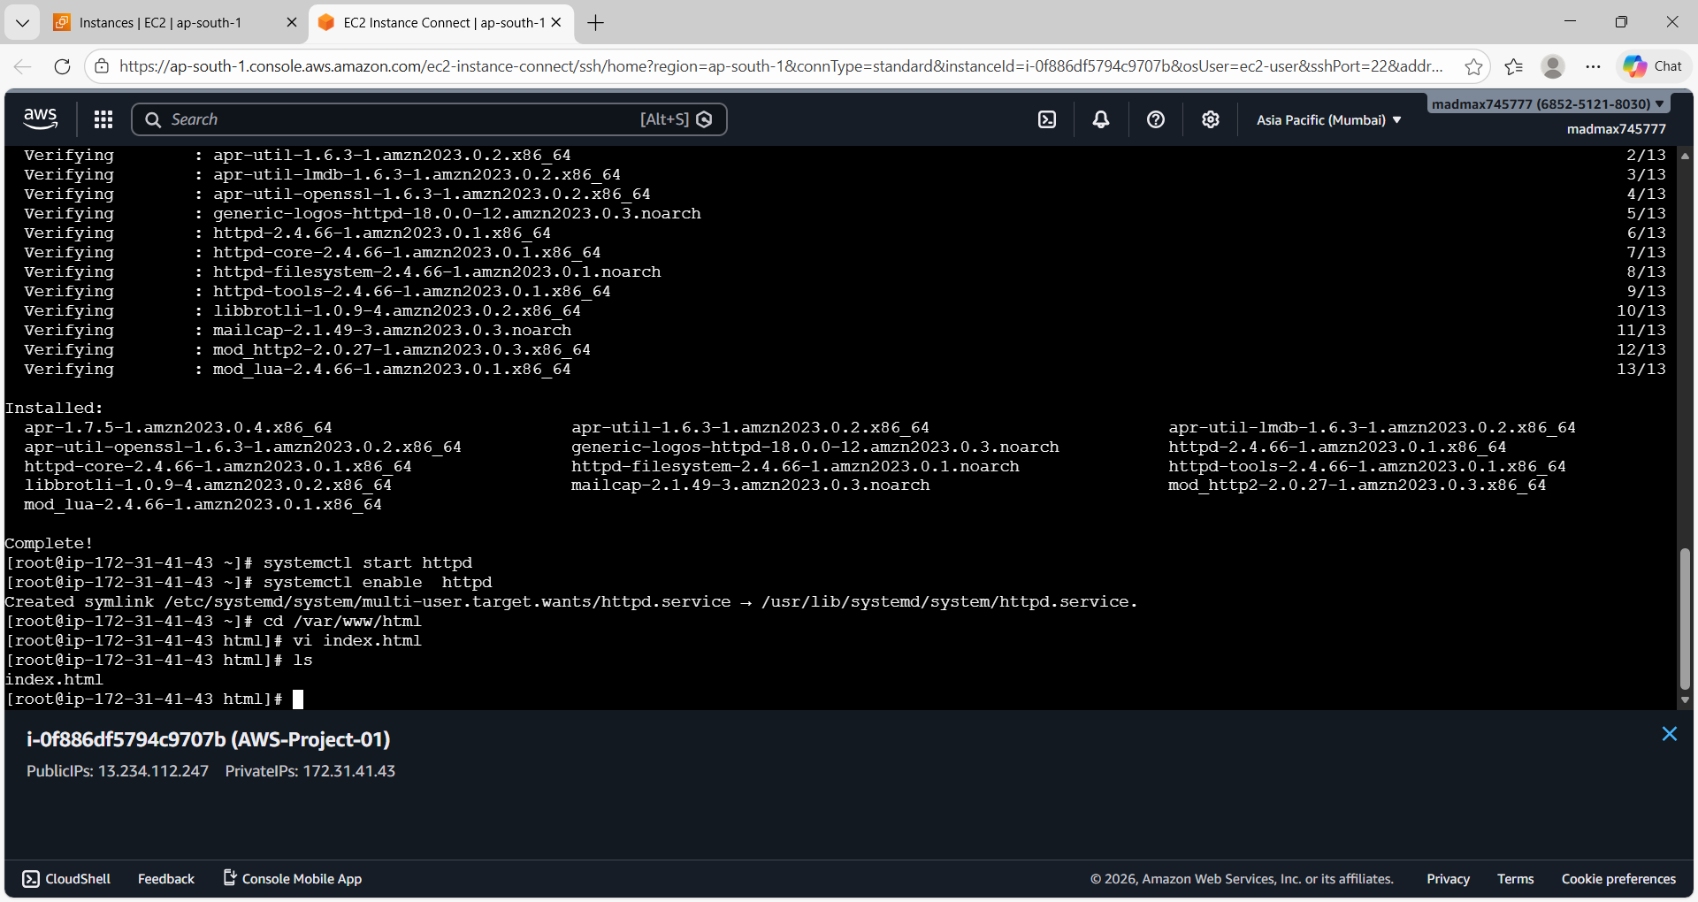
Connect ec2 instance and install and start HTTPD

Slide 6
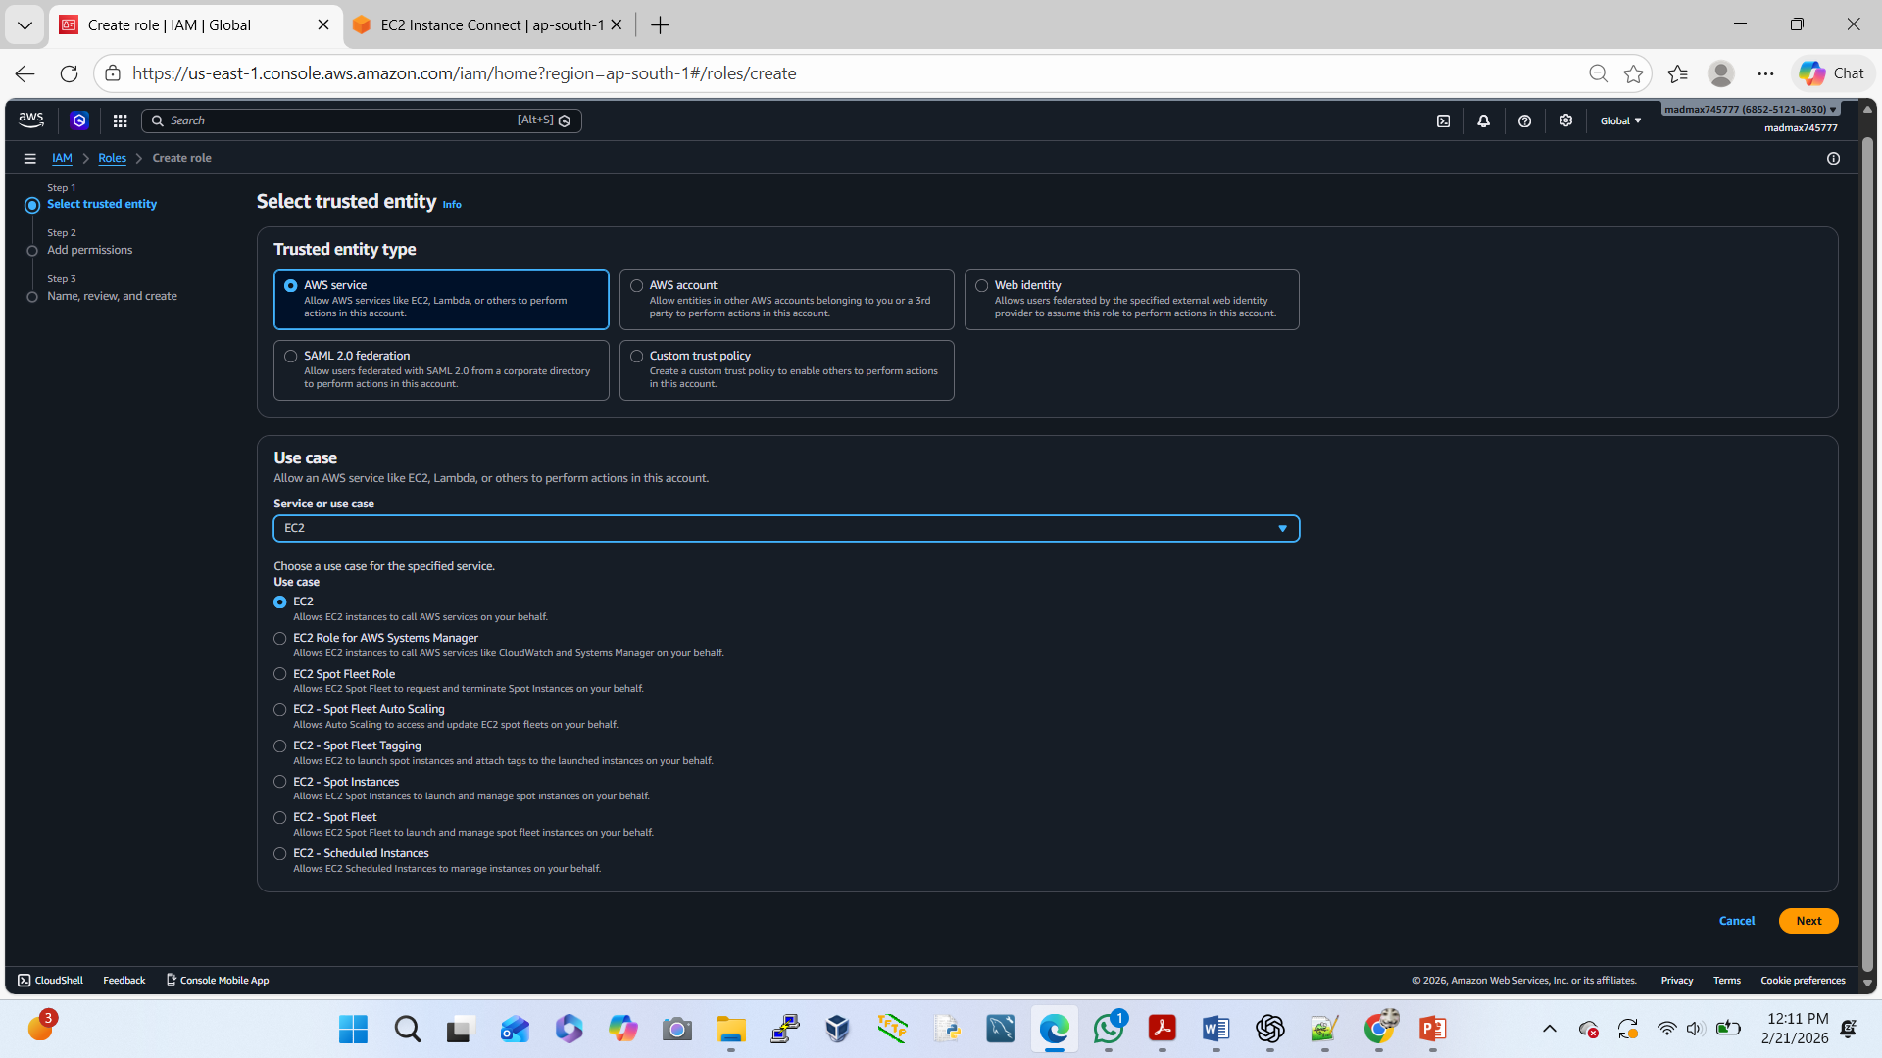
To create an IAM Roles (Here follow 2page: add permission, name, review and create )

Slide 7
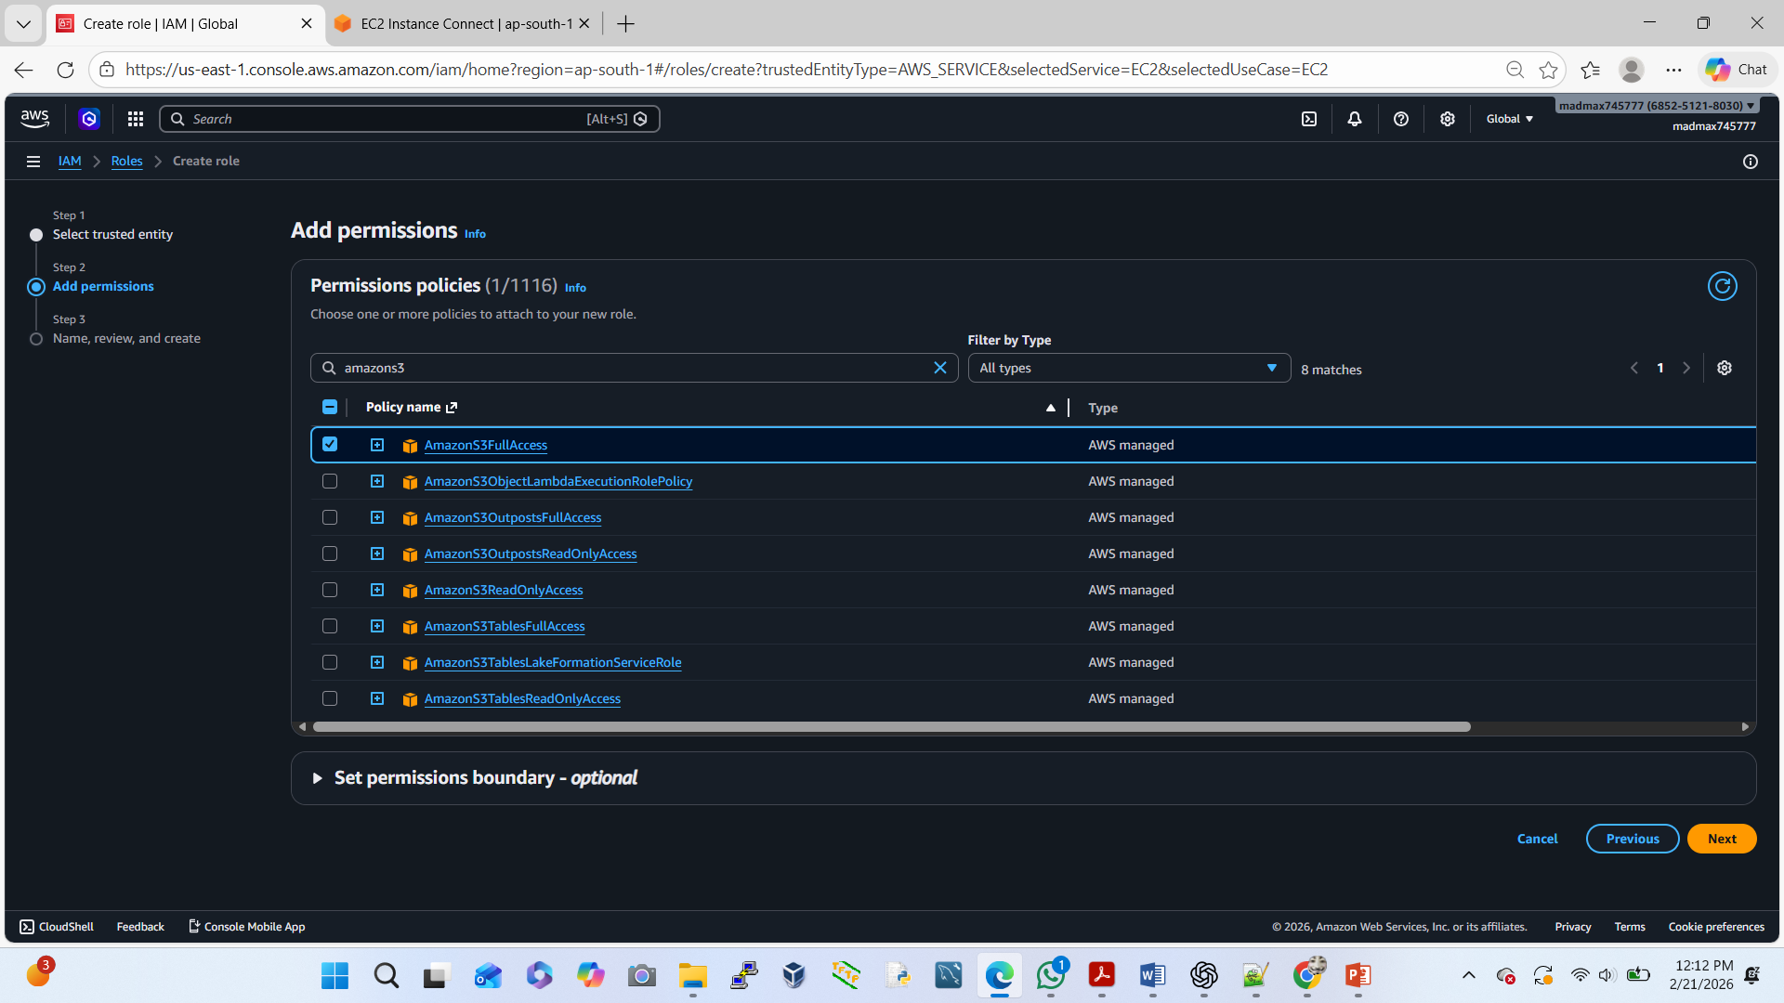
To add IAM Roles Permission (AmazonS3FullAccess)

Slide 8
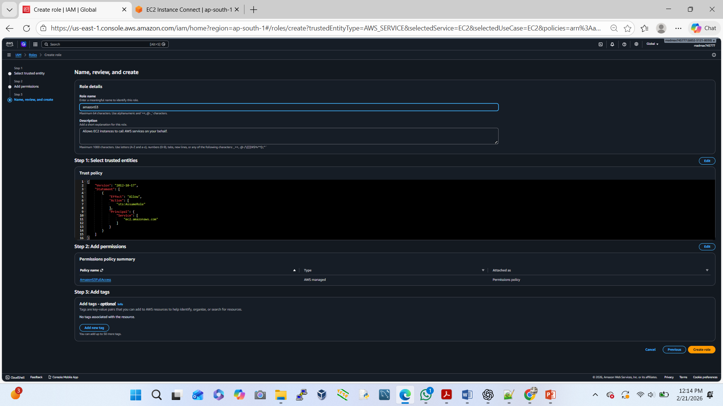
To check the IAM Role last page review

Slide 9
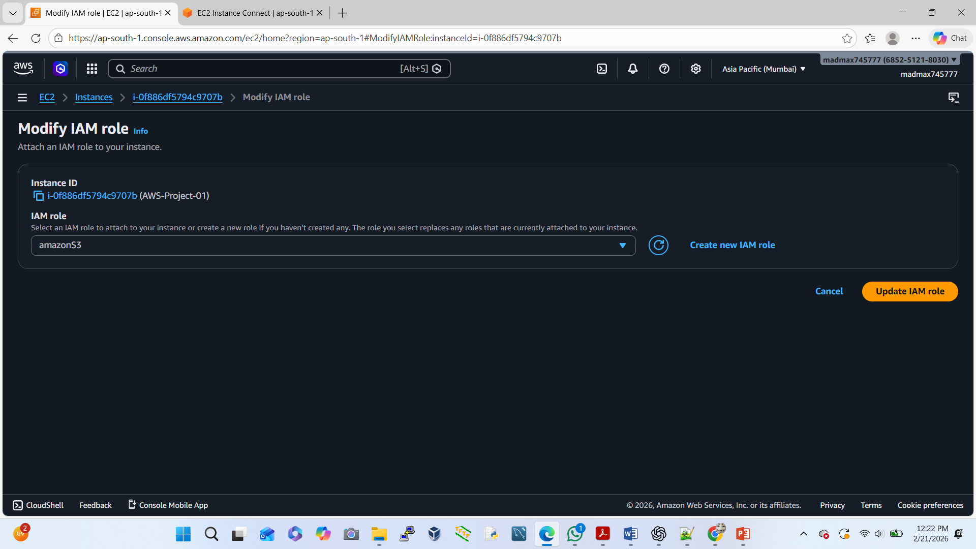
Go to the Exist Ec2 instance select instance id or to modify IAM Role

Slide 10
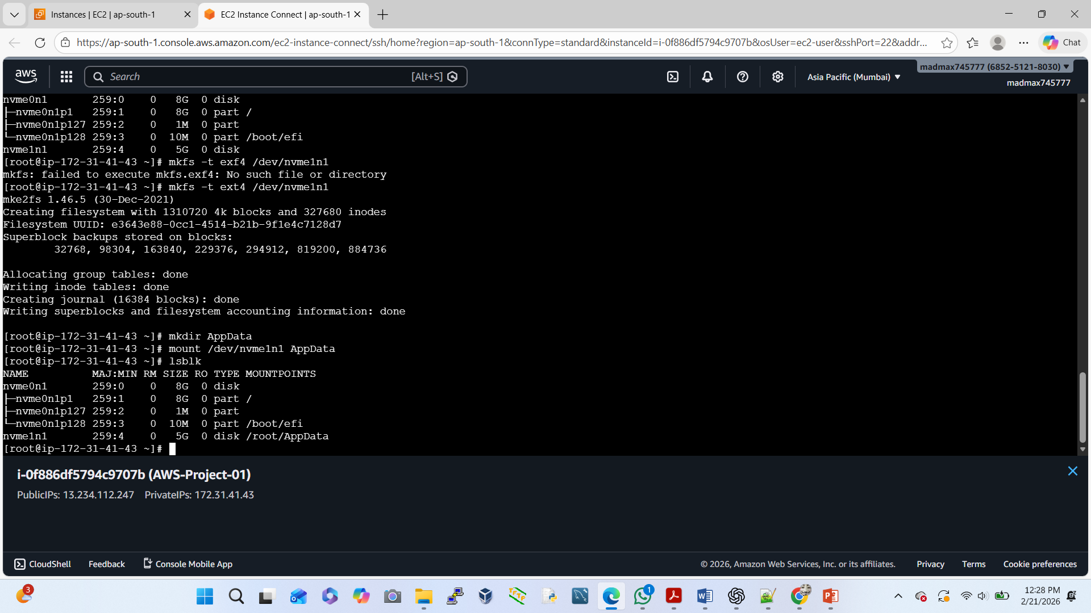
To create a Directory after that mount then we are check cmd lsblk

Slide 11
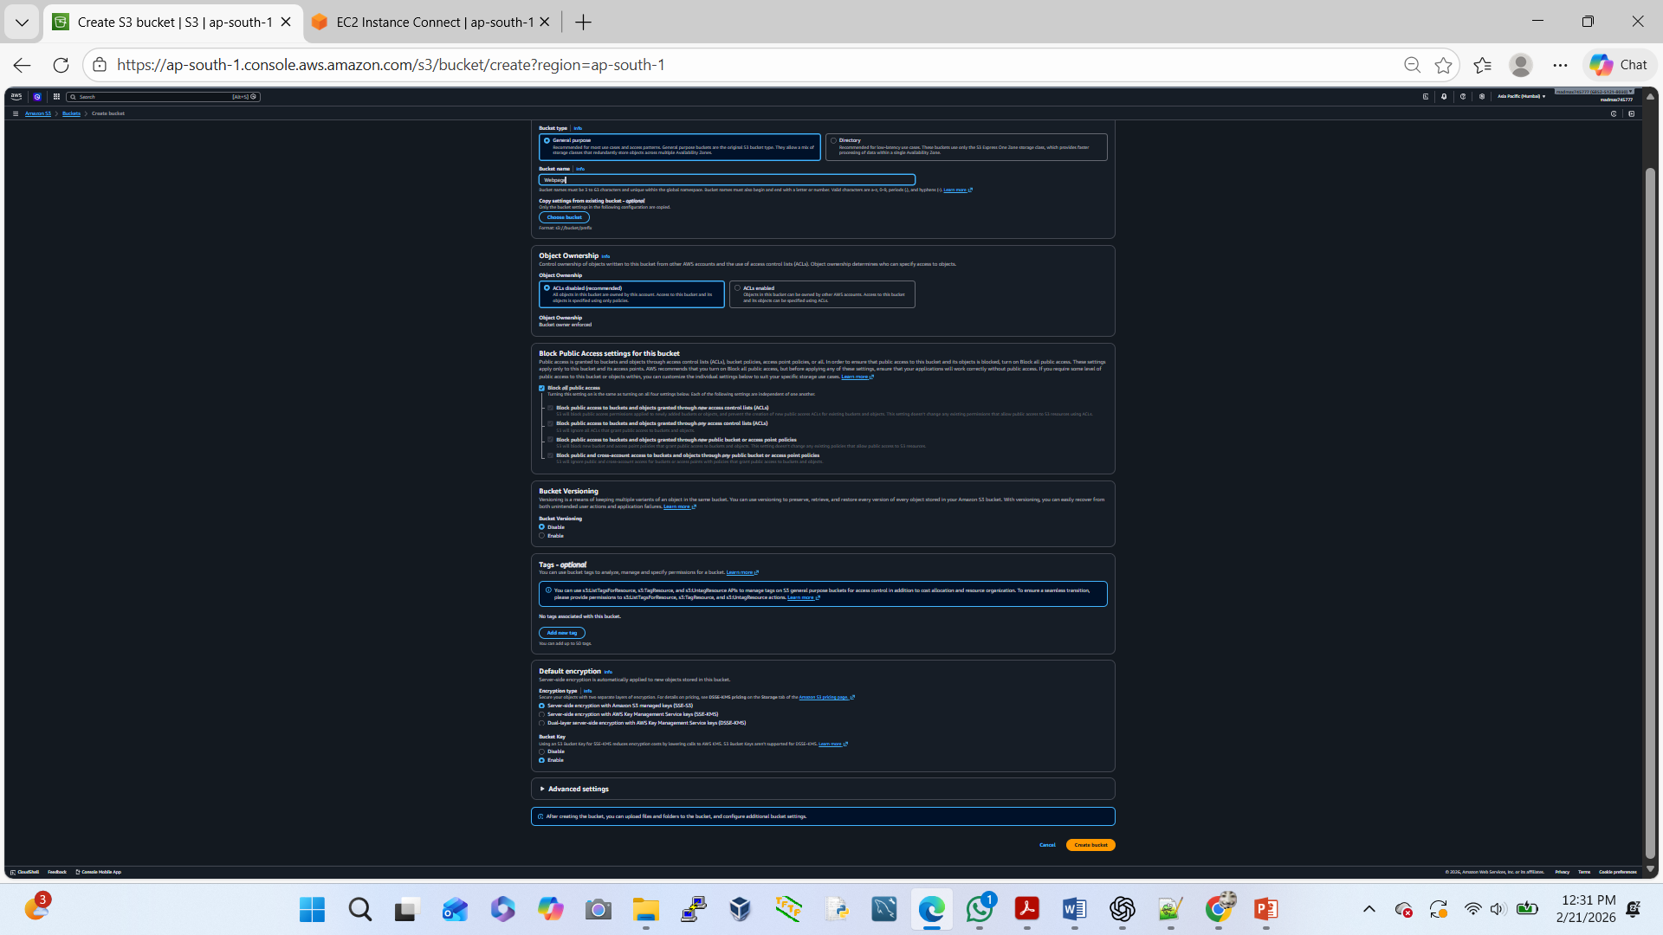
To create a new Private S3 Bucket

Slide 12
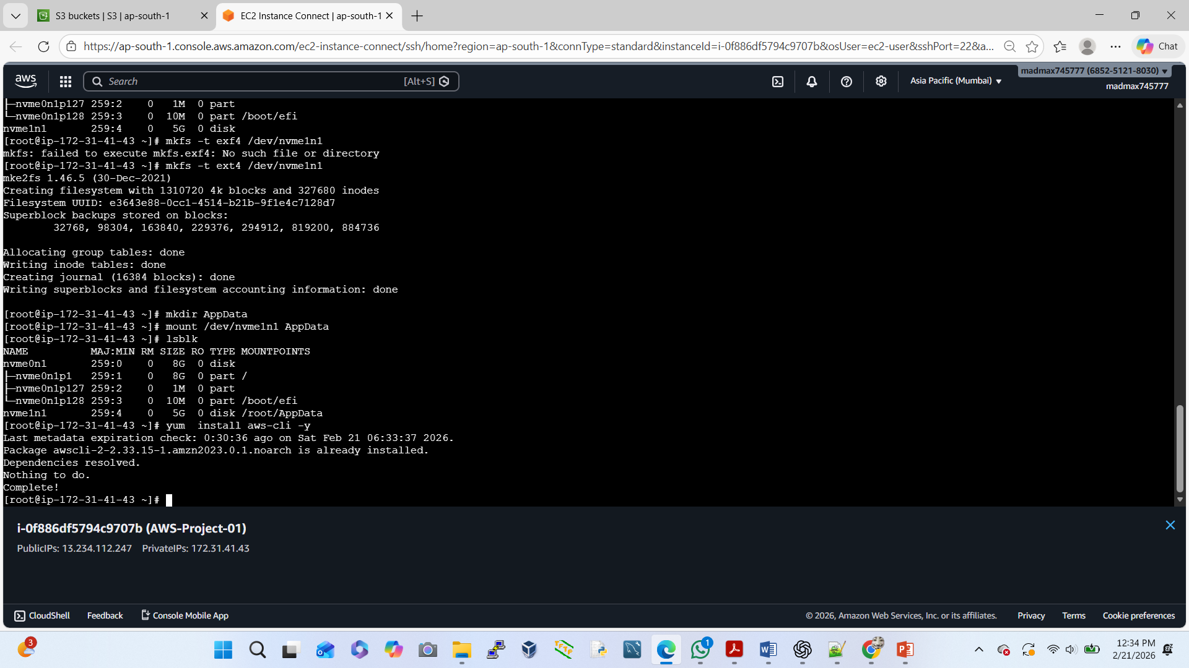
Go to the EC2 instance CLI mode after that install AWS CLI

Slide 13
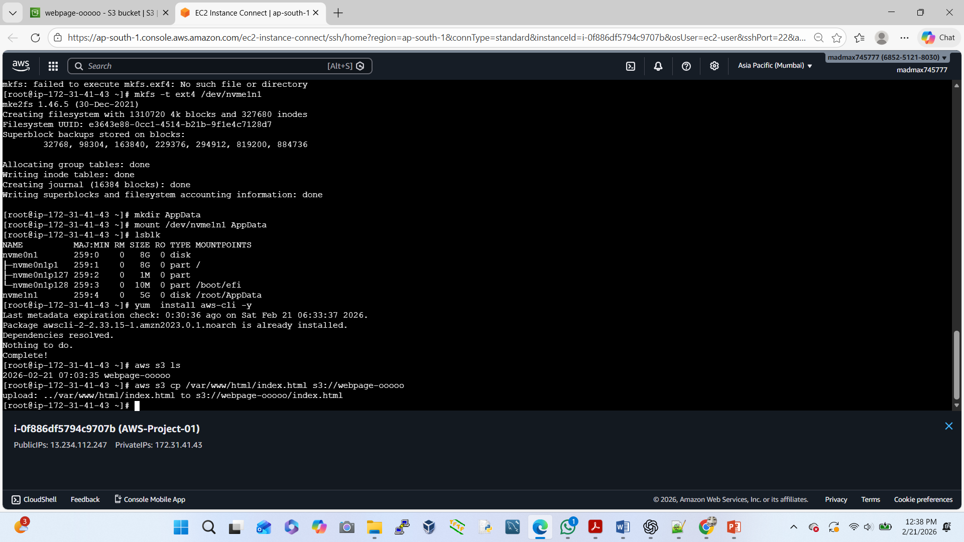
To create a Duplicate Data copy Server to S3 bucket (aws s3 cp /var/www/html/index.html s3://webpage-00000)

Slide 14
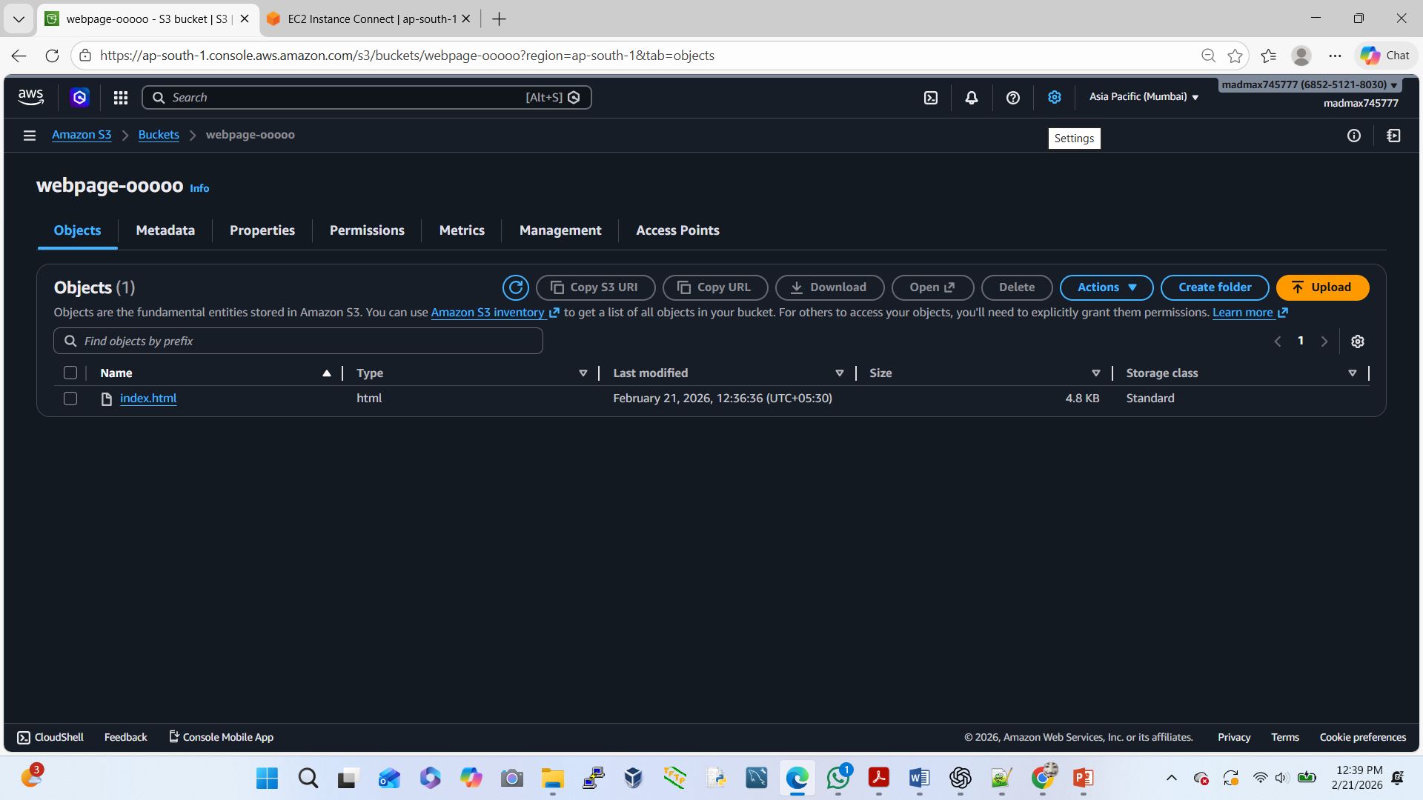
Go to the Bucket after that refresh/check our index.html file copy or not.

Slide 15
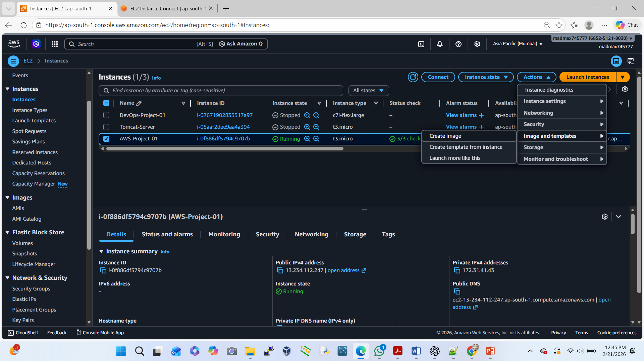
Go to Ec2 Instance –Action—image & template –create image

Slide 16
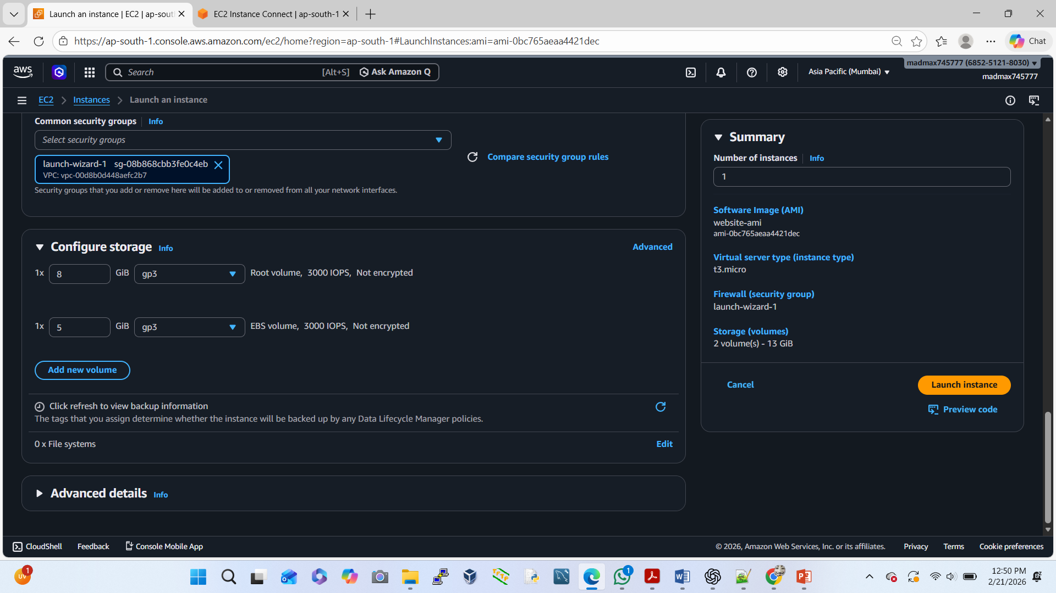
Launch EC2 in another AZ using AMI

Slide 17
Test high Availability open new instance public ip
Go to the Chrome/Google new tab open
To paste the public ip here (chrome)
After that we can see our web-page/webapp

